Slide 1
OrganIzatIonal DesIgn CHAPTER 3 - ENVIRONMENT
Efe Erdur

Slide 2
OUTLINE
Introduction to Environment
The environment space
Calm environment
Varied environment
Locally stormy environment
Turbulent environment

Slide 3
IntroductIon to EnvIronment
The environment is everything outside the boundary of the organizational unit of analysis.
what could have an effect on the way the organization performs.
customers, competitors, suppliers, the financial market, or the political system
The performance of the firm depends upon how a firm makes the organization fit with the environment.
The firm should then adjust its design to fit the environment.
Notes:
If a firm is a monopolist, it does not have any relevant competitors. On the other hand, if a firm is in a very strong competitive market, the most significant dimension in its environment may be its competitors.

Slide 4
IntroductIon to EnvIronment
The common aspects of different definitions;
Environment variables are general properties of an organization’s environment, not a detailed listing of all of the elemental factors themselves.
The measures are perceptions made by the management of the firm; they are not necessarily objective.
The environment is a large determinant of the organizational design.

Slide 5
IntroductIon to EnvIronment
The environment refers to the forces surrounding an organization that impact its performance.
For the firm as a whole; the environment usually is the competitive marketplace.
For a department or business unit, it includes upper management and the other units of the firm that affect the business of the department.
For a team, the environment is the department, other organizational units in which the team operates, and possibly other teams that influence the team’s workload and its success in carrying out its tasks.

Slide 6
IntroductIon to EnvIronment
How to describe an organization’s environment?
Complexity is measured as the number of factors in an organization’s environment and their interdependency
Unpredictability is lack of understanding or ignorance of the environment in terms of the nature of the factors and their variance; greater variance means less predictability.

Slide 7
IntroductIon to EnvIronment
The two environmental characteristics are general attributes.
Complexity refers to the number of powerful forces affecting an organization.
Unpredictability is the degree of uncertainty about the forces that impact a firm.
Notes:
If a firm has only one or two major competitors it faces low complexity; whereas if a firm must continually adjust to numerous conditions – competitors, prices, labor pool, new products – it faces high complexity. The higher the environmental unpredictability, the less accurate the forecasts are and the more uncertain management can be about the future.

Slide 8
IntroductIon to EnvIronment
Dynamic structure, complexity, uncertanity...
Should the description of an organization’s environment be objective or subjective?
In any way;
Organizations need to continually monitor their environment.
You may be able to predict much more precisely a firm’s environment by talking to customers, or suppliers, or politicians, or specialized research firms.
Notes:
You will often find that firms in the same industry, confronting the same environment, behave differently.
One reason why this occurs is that they perceive and categorize the same environment very differently.

Slide 9
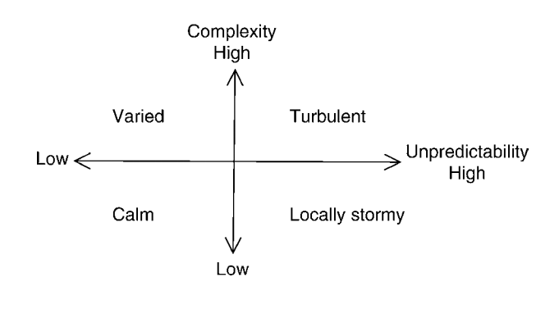
IntroductIon to EnvIronment
The Environment Space
Notes:
Each of the four environmental categories is a different combination of complexity and unpredictability.
If a firm is in a calm environment, then the environment is low in complexity and is predictable. you know what is important in the environment with a good deal of certainty. There are no surprises and few adjustments are required.
If a firm is in a varied environment, then the environment is high in complexity but is predictable. There are many interdependent factors, but these are well known and predictable. If a firm is in a locally stormy environment, then the environment is low in complexity, but unpredictable. There are few and usually independent factors, but they are not predictable.
If a firm is in a turbulent environment, then the environment is high in complexity and is unpredictable. There are many interdependent factors which are unpredictable.

Slide 10
Calm envIronment
A calm environment has low complexity and low unpredictability
It is simple and known with few surprises.
The political and financial issues usually are not major challenges for management
No need to spend much time assessing organization’s environment
The presumptions of a calm environment by an executive is potentially risky!
Notes:
If a firm only has a few products and sells them into markets where the markets are predictable, we say it has a calm environment.

Slide 11
VarIed envIronment
The varied environment is complex as there are many factors to take into consideration and they can be interdependent (i.e., they influence one another)
But these factors are relatively predictable and/or they tend to change within known limits.
If a firm has many products and sells them into markets where the markets are predictable, we say it has a varied environment.
Notes:
In such a varied environment there are many factors for an organization to consider, but it is possible to predict what will occur.

Slide 12
VarIed envIronment
In earlier times, the toy manufacturer LEGO was in a varied environment. It operated in many countries with many different variations of its products, and there were many legal, financial, and logistic issues to take into consideration.
Demand had seasonal variations but it was quite predictable.
But that environment changed around 2000 to a locally stormy environment, where the sales were rather unpredictable.

Slide 13
Locally stormy envIronment
Highly unpredictable but not very complex.
There are a few factors in the environment which are relatively independent, but they are unpredictable.
Executives are most concerned about the unpredictability of environmental factors that affect their firm.
Notes:
Unpredictability means that the response time in which the firm has to react is much shorter than if the environment were predictable.
In a predictable environment a firm has time to plan for the future; but in an unpredictable situation the peak information requirement is much higher as you have to do many things when the unpredictable factors in the environment suddenly become known.

Slide 14
Turbulent envIronment
Both high complexity and high unpredictability.
This environment is analogous to that faced by a farmer
As a manager, this is the most difficult environment in which to operate as it requires limited forecasting and also the flexibility of quick and coordinated adjustments as events become known.
Notes:
This environment is analogous to that faced by the farmer who has not only the rain to consider but also the market price for grain, and the rain and price may be correlated; further, both are difficult to predict.

Slide 15
Turbulent envIronment
Today’s global airlines confront a turbulent environment.
many factors to consider:
the ticket prices of other global competitors
the emergence of new low price competitors
the global price of jet fuel
the global security situation
the competition from nontravel substitutes such as video conferencing
etc.

Slide 16
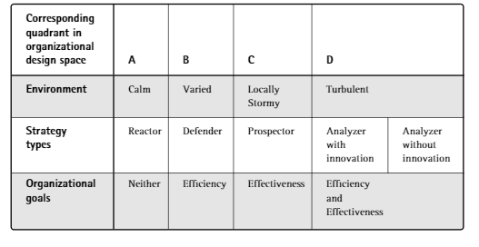
Fit among organizational environment, strategy, and organizational goals

Slide 17
THANK YOU FOR LISTENING!

